Slide 1
ME623: Finite Element Methods in Engineering Mechanics
Instructor: Sumit Basu
Email: sbasu@iitk.ac.in
Phone office: (0512 259) 7506
Office: NL211A
Phone residence: (0512 259) 8511
TexPoint fonts used in EMF.
Read the TexPoint manual before you delete this box.: AAAAAAAAA

Slide 2
Coursenotes, assignments and announcements will all be made in Backpack (http://www.usebackpack.com).
Coursecode is 063085
The Google Calendar for the course is available at
https://calendar.google.com/calendar?cid=ZHIuc3VtaXQuYmFzdUBnbWFpbC5jb20

Slide 3
Evaluation Policy
The endsem and midsem exams will be the only exams that we will conduct. Each of these will carry 50% weight. These will be ‘pen and paper’ tests based on theoretical aspects of the FE method.
Several assignments meant to help your understanding of the techniques will be given from time to time. If you want to learn the method seriously, I suggest that you try these out.
Coding workshops will be held in the Linux Lab in the New Core Building.

Slide 4
Books
Elementary books covering a wide range of problems
Concepts and applications of Finite element analysis: Cook, Malkus and Plesha, John Wiley and Sons, 2003.
T.R. Chandrupatla and A.D. Belegundu, Introduction to Finite Elements in Engineering, Second Edition, Prentice-Hall, 1997.
Daryl Logan, A First Course in Finite Element Method, Thomson, India Edition
Somewhat more advanced texts dealing less with procedures and more with ideas behind the technique
K-J Bathe, Finite Element Procedures in Engineering Analysis, Prentice-Hall of India, 1990
O C Zienkiewicz and R L Taylor, The Finite Element Method: Its Basics and Fundamentals, Butterworth Heinemann, 2007
J N Reddy, An Introduction To Finite Element Method, Tata McGraw Hill, 2005

Slide 5
Why do we need to simulate things?
Seeing is believing.
Sophisticated experiments can tell everything. Why do we need the FE method?
Experimental results are subject to interpretation. Interpretations are as good as the competence of the experimenter.
Experiments, especially sophisticated ones, can be expensive
There are regimes of mechanical material behaviour that experiments cannot probe.
Generality of behaviour is often not apparent from experiments.
Experiments and simulations are like two legs of a human being. You need both to walk and it does not matter which you use first!

Slide 6
FEA has become extremely important in engineering design
The FEM has attained a level of generality that makes it suitable for a very wide range of engineering and scientific problems that require solution of governing partial differential equations with well defined boundary conditions. These include, solid and fluid mechanics, structural mechanics, biomechanics, quantum mechanics, electromagnetics, geomechanics …
The mathematical basis of the FEM is well understood and the discretisation equations for FEM arise out of well established principles.
FEM simulations form important part of safety assessment procedures for Reactor Pressure Vessels in nuclear power plants, aircraft industry, crashworthiness of automobiles, earthquake resistance of buildings etc.
Powerful commercial softwares that combine modelling algorithms with the power of FEM are now easily available. Extermely realistic problems may be solved given the enormous increase in computational power.

Slide 7
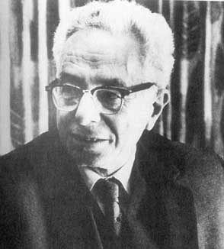
How did it evolve?
1943: Richard Courant, a mathematician described a piecewise polynomial
solution for the torsion problem of a shaft of arbitrary cross section. Even holes.
The early ideas of FEA date back to a 1922 book
by Hurwitz and Courant.
His work was not noticed by engineers
and the procedure was impractical at the time due to the lack of digital computers.
1888-1972: b in Lublintz Germany
Student of Hilbert and Minkowski in Gottingen Germany
Ph.D in 1910 under Hilbert’s supervision.
1934: moved to New York University, founded the Courant Institute

Slide 8
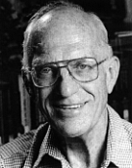
In the 1950s: work in the aircraft industry introduced FE to practicing engineers.
A classic paper described FE work that was prompted by a need to analyze
delta wings, which are too short for beam theory to be reliable.
1960: The name "finite element" was coined by structural engineer Ray Clough
of the University of California
By 1963 the mathematical validity of FE was recognized and the
method was expanded from its structural beginnings to include heat transfer,
groundwater flow, magnetic fields, and other areas.
Large general-purpose FE software began to appear in the 1970s.
By the late 1980s the software was available on microcomputers,
complete with color graphics and pre- and post-processors.
By the mid 1990s roughly 40,000 papers and books about
FE and its applications had been published.
Professor emeritus of Structural Engineering at UC Berkley
Ph.D from MIT
Well known earthquake engineer

Slide 9

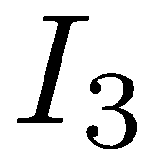


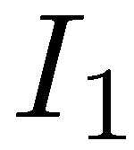
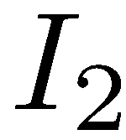


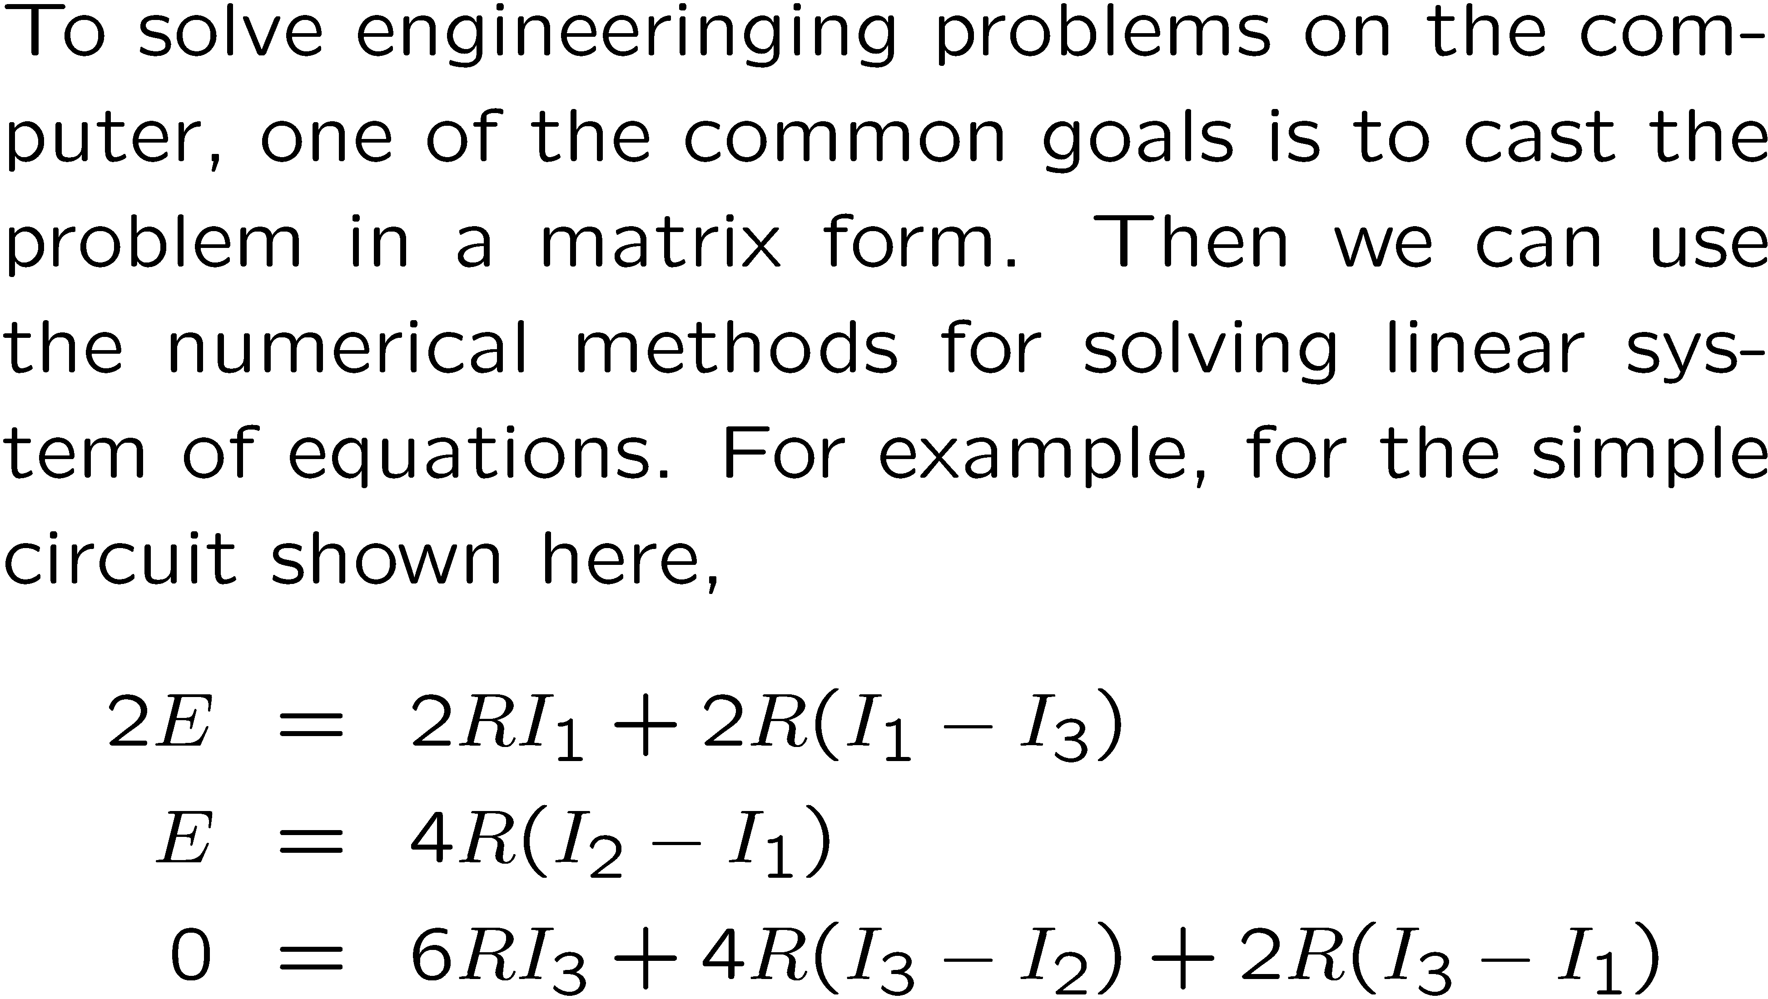
Solving Engineering Problems
4
2
3
1
B
A

Slide 10
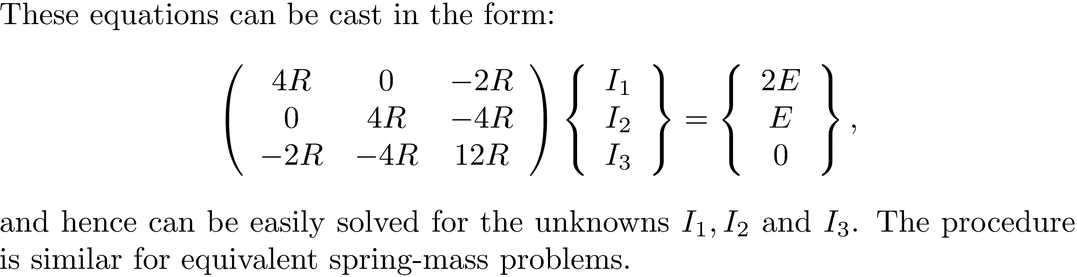

Slide 11

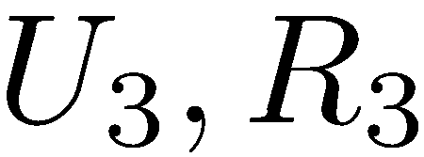
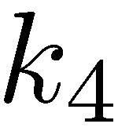
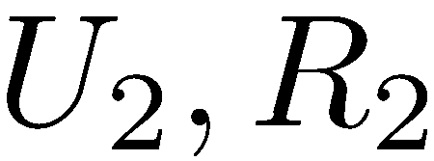
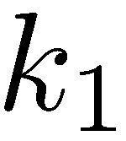
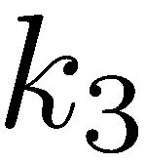
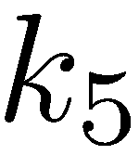
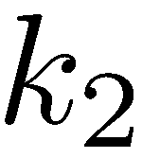
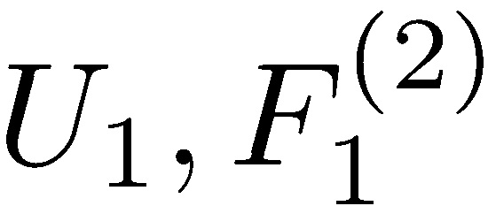
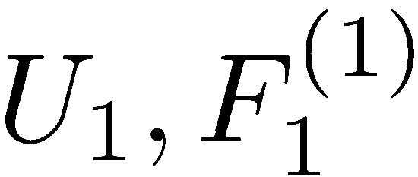
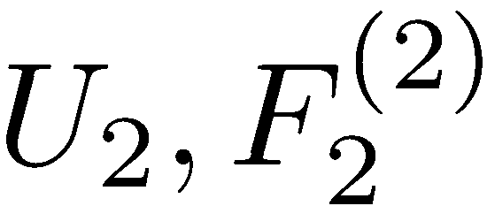
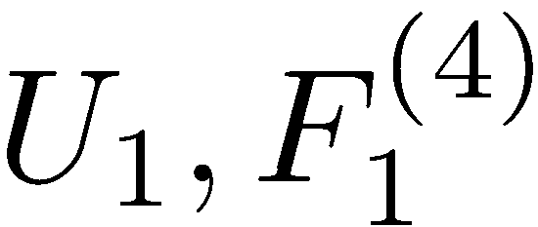
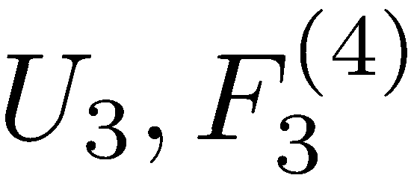
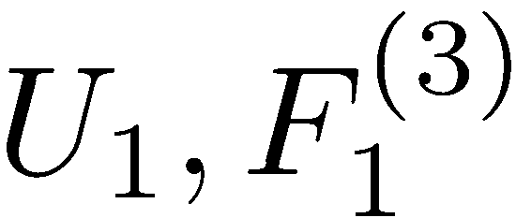
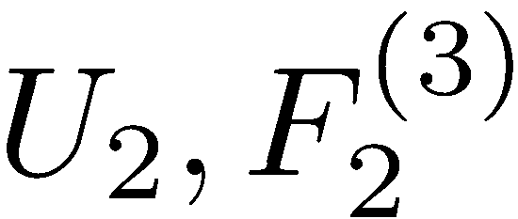
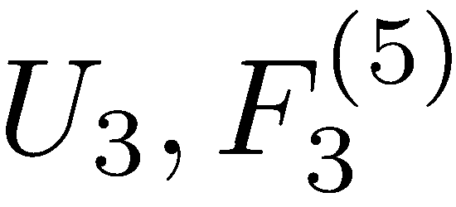
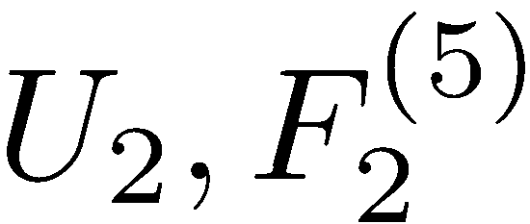
1
3
2

Slide 12
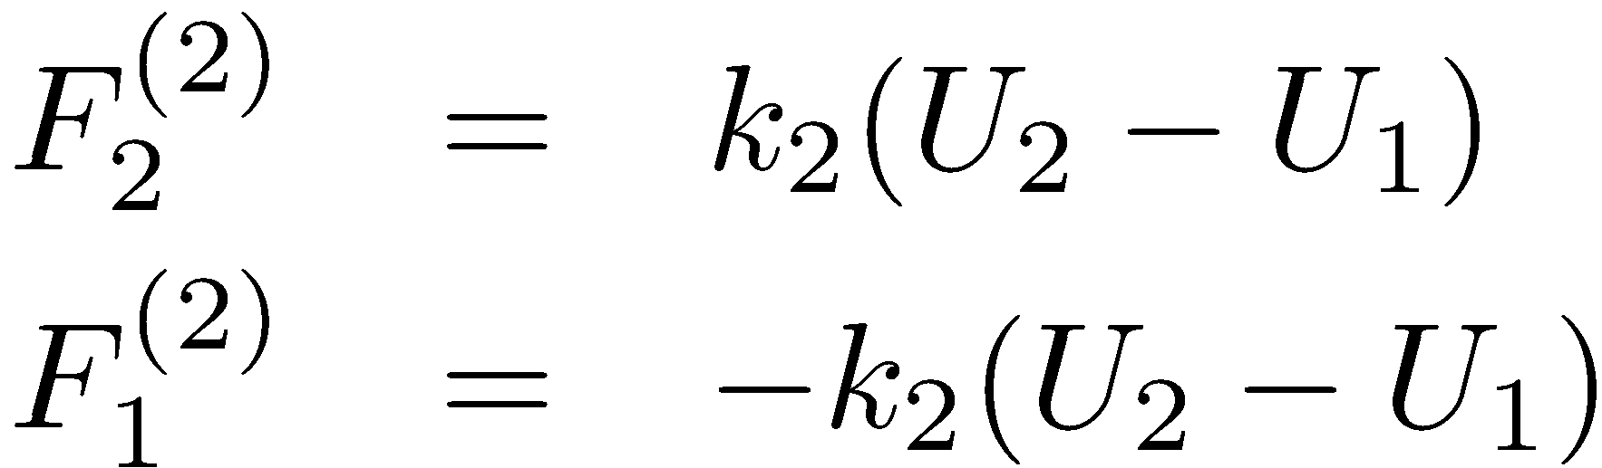
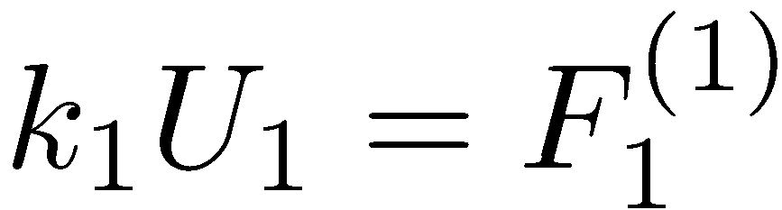

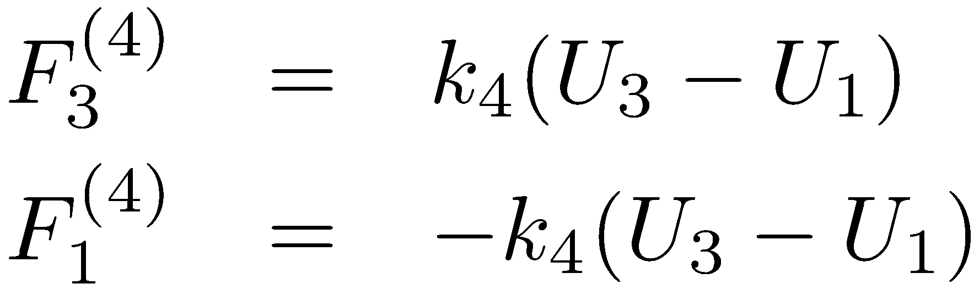


Slide 13
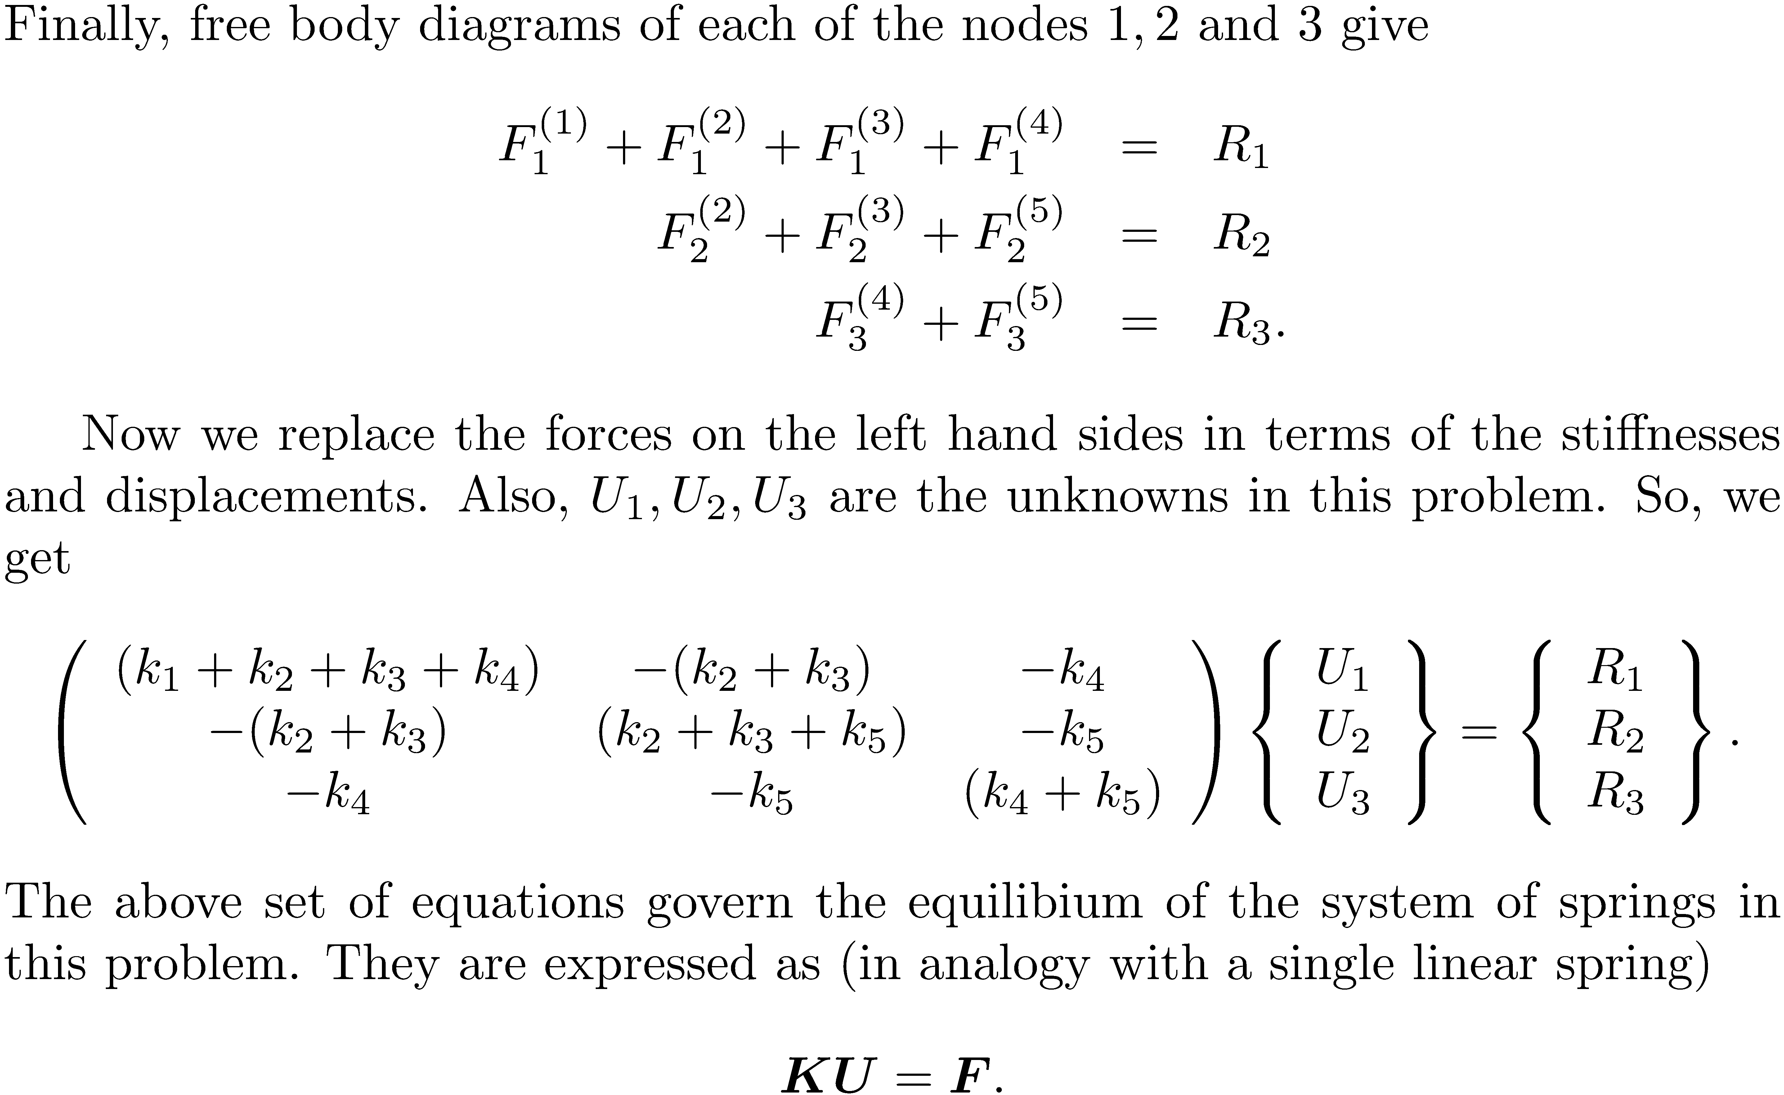

Slide 14
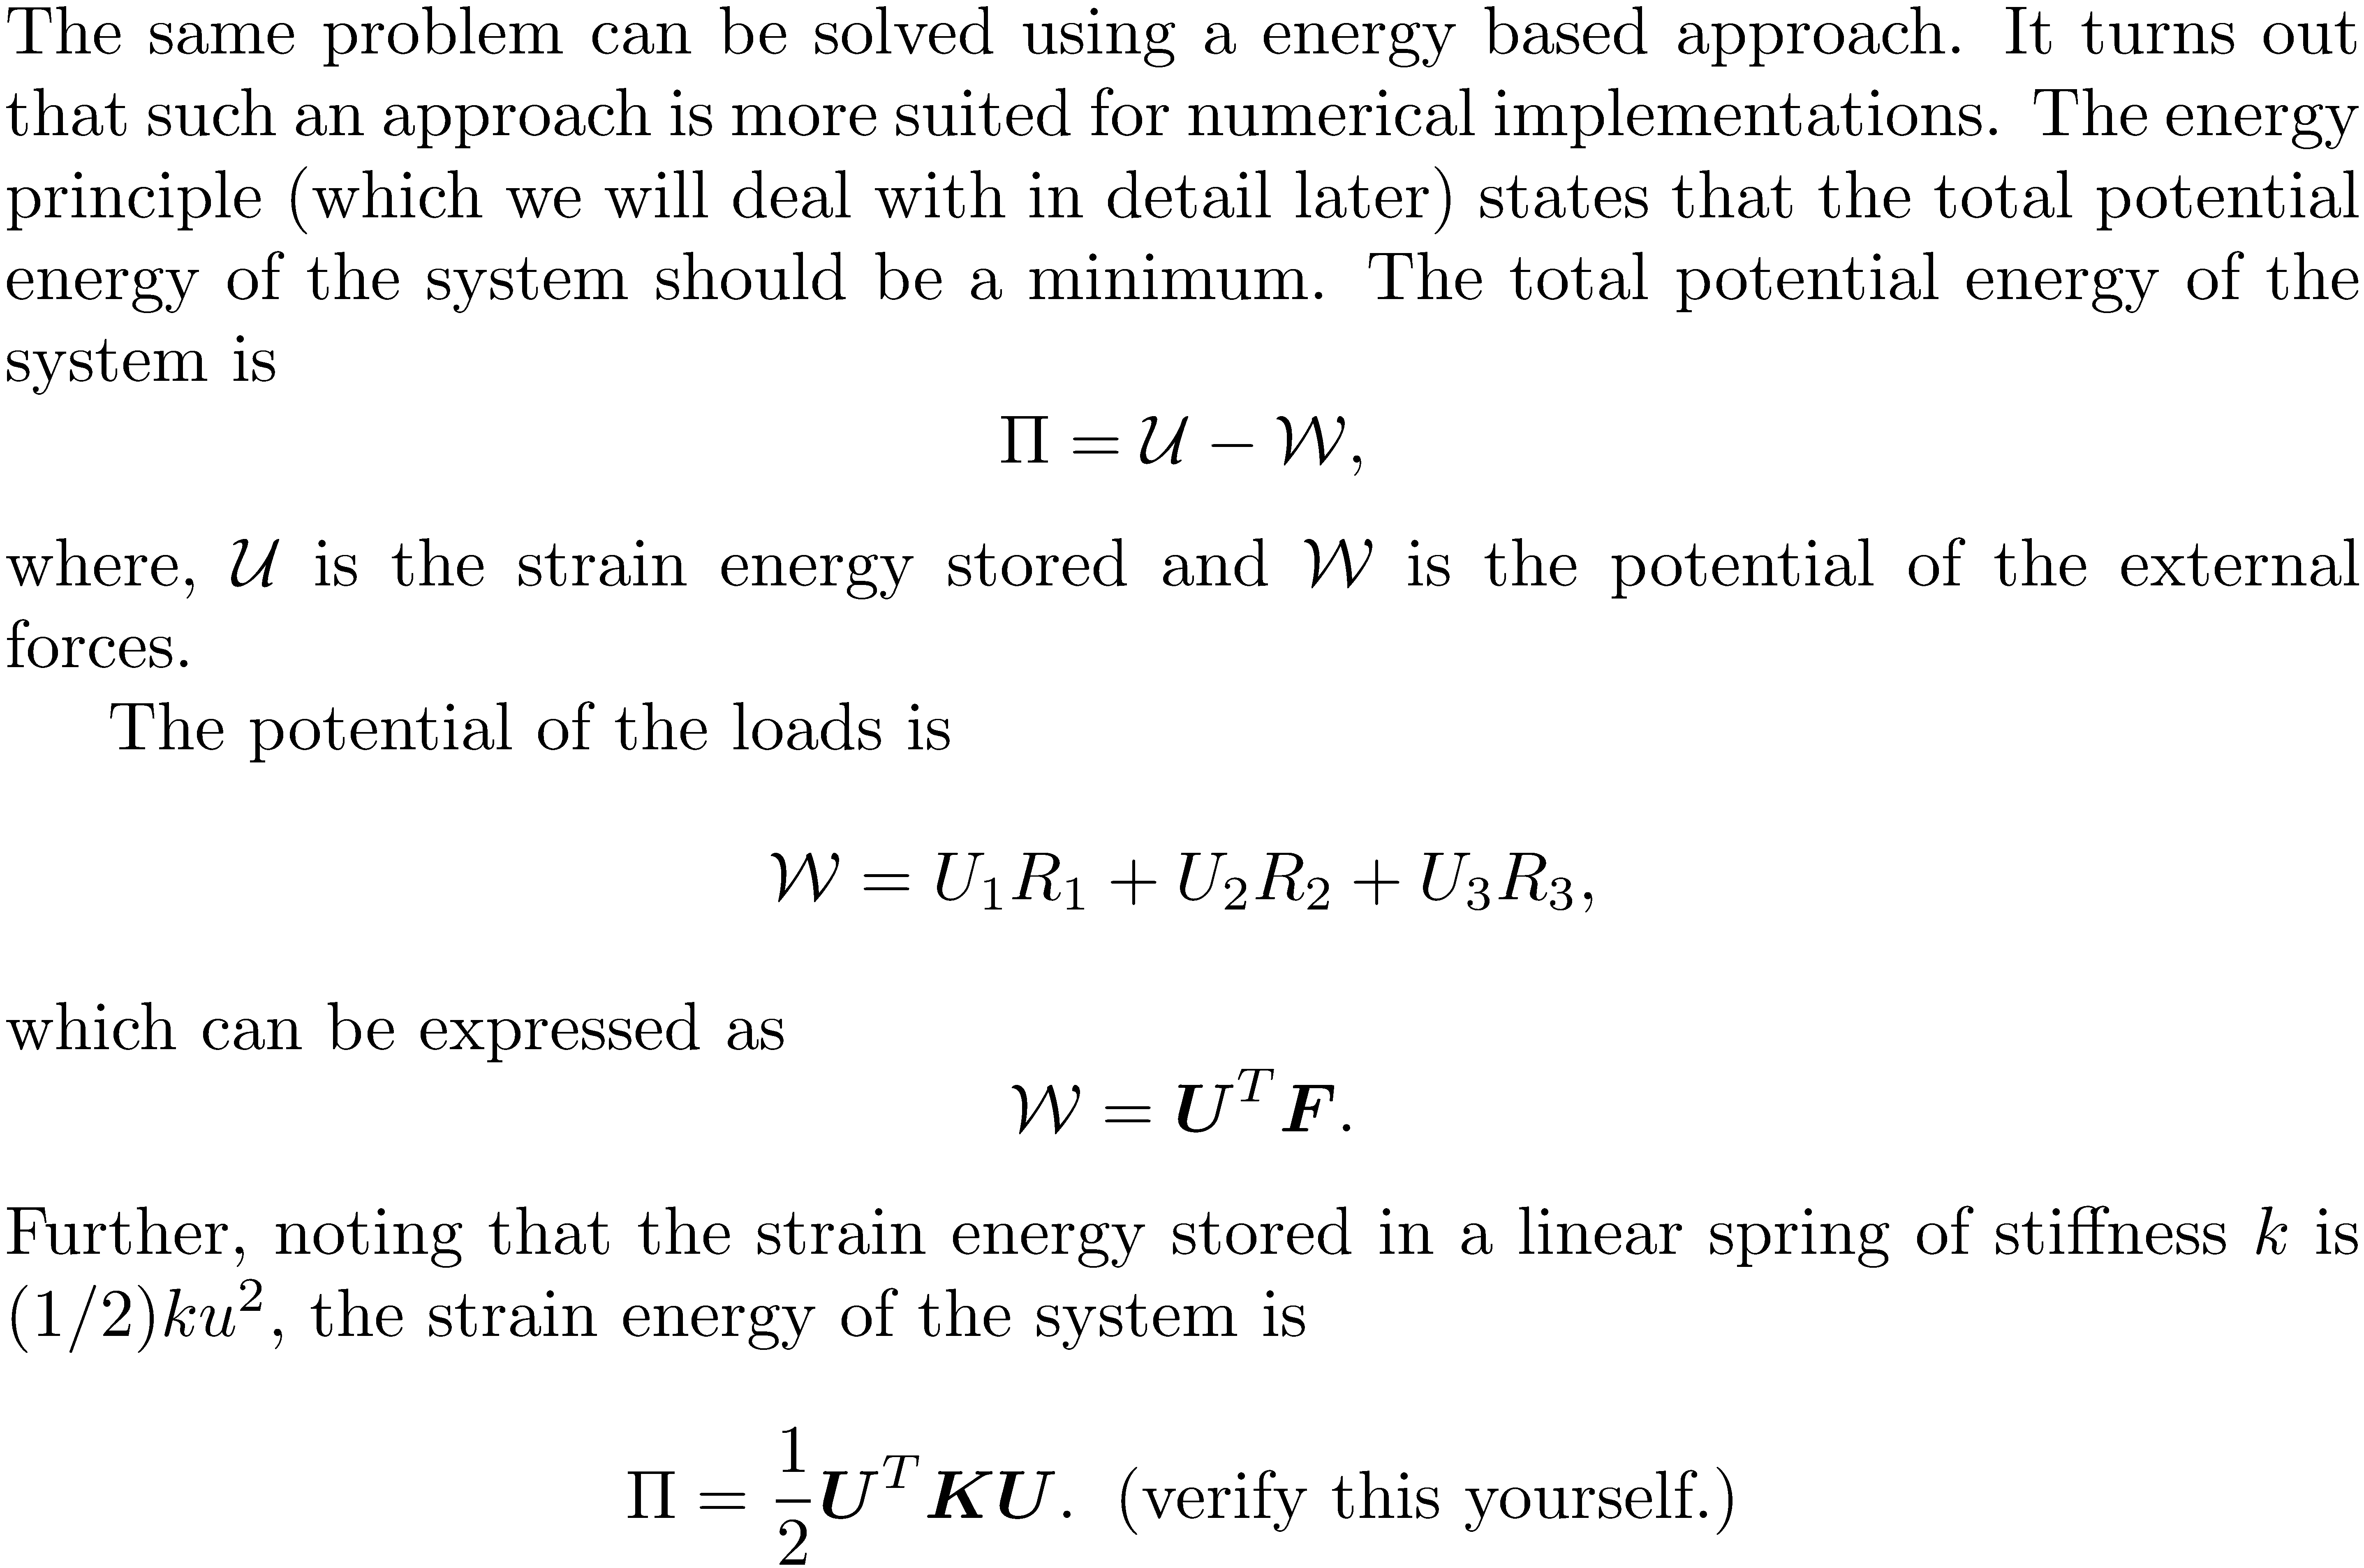

Slide 15
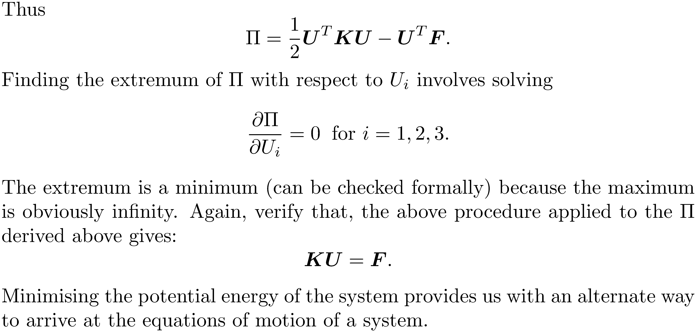

Slide 16
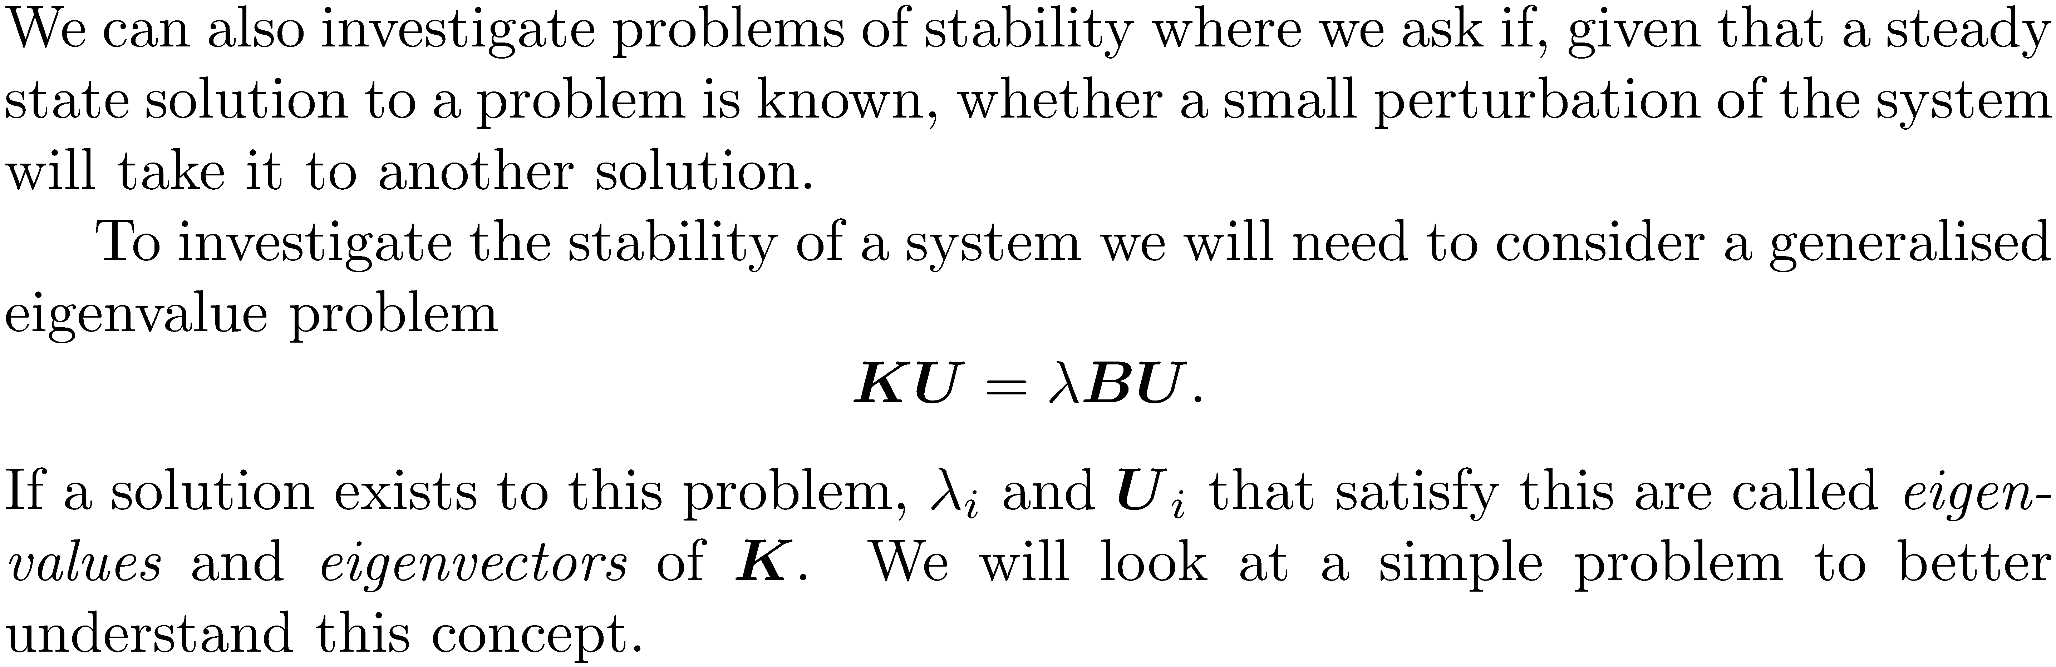

Slide 17







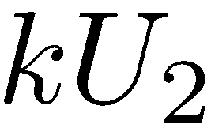
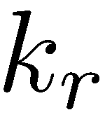
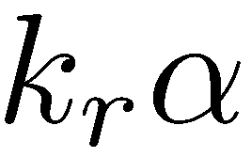
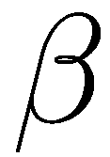

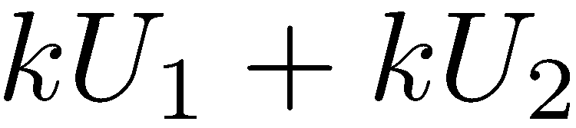
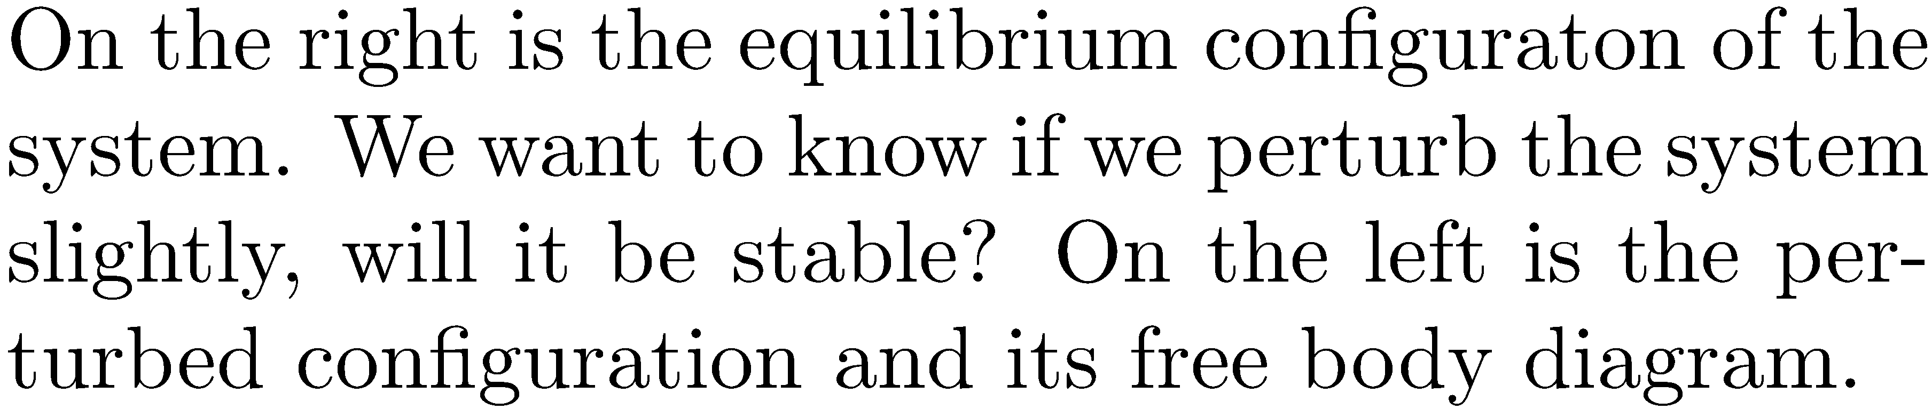

Slide 18
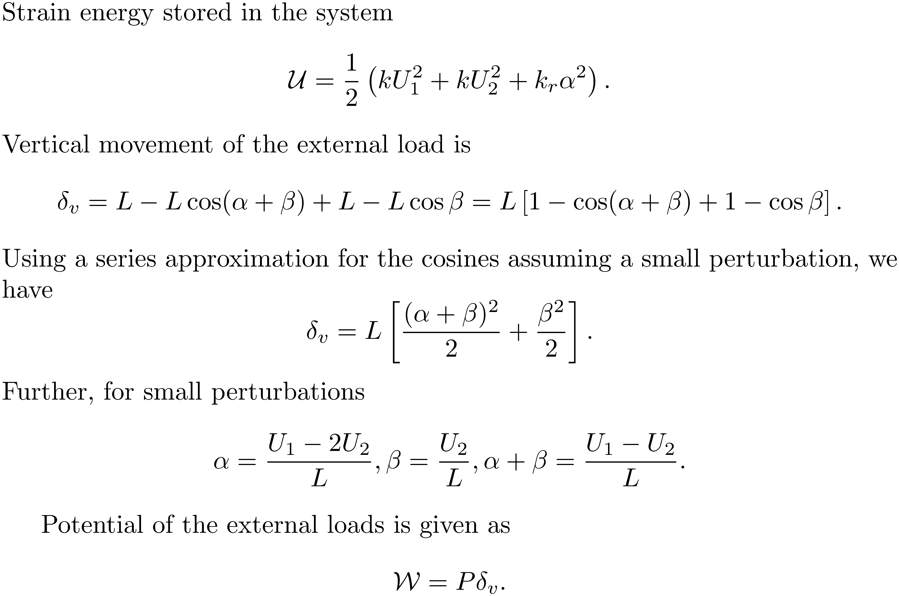

Slide 19
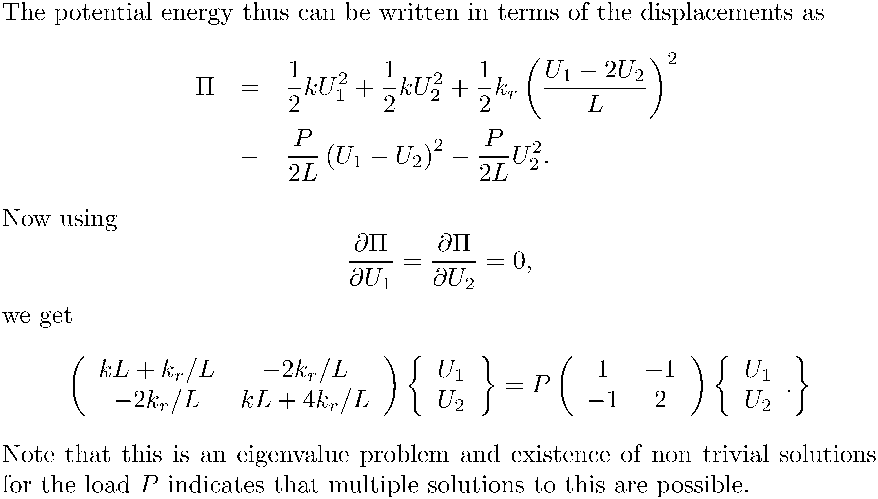

Slide 20
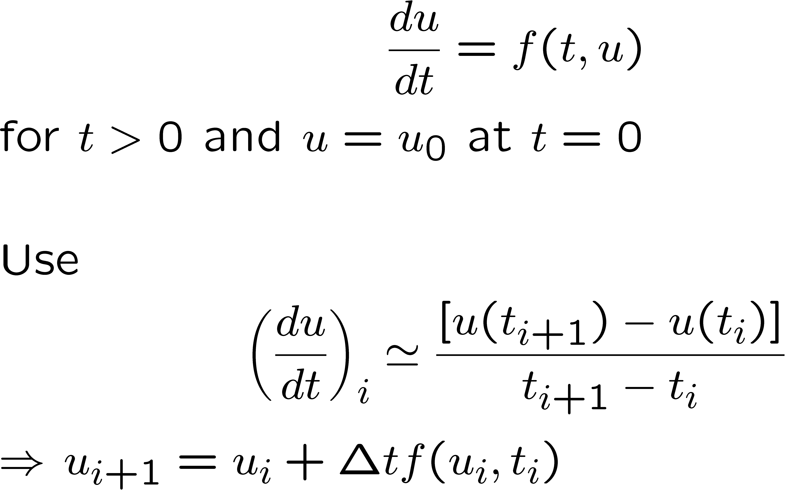
Solving problems governed by differential equations: finite difference techniques
Mathematical model: an equation of motion
Euler’s explicit scheme or first order Runge Kutta scheme

Slide 22
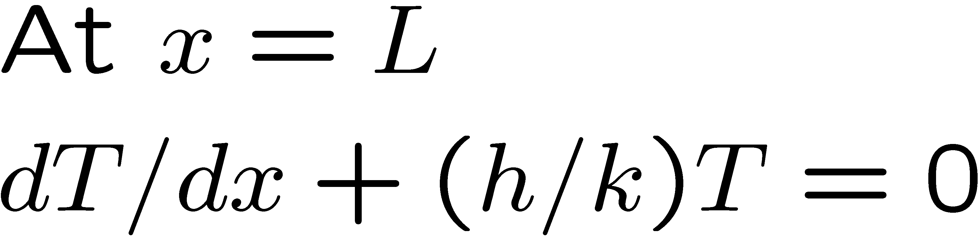
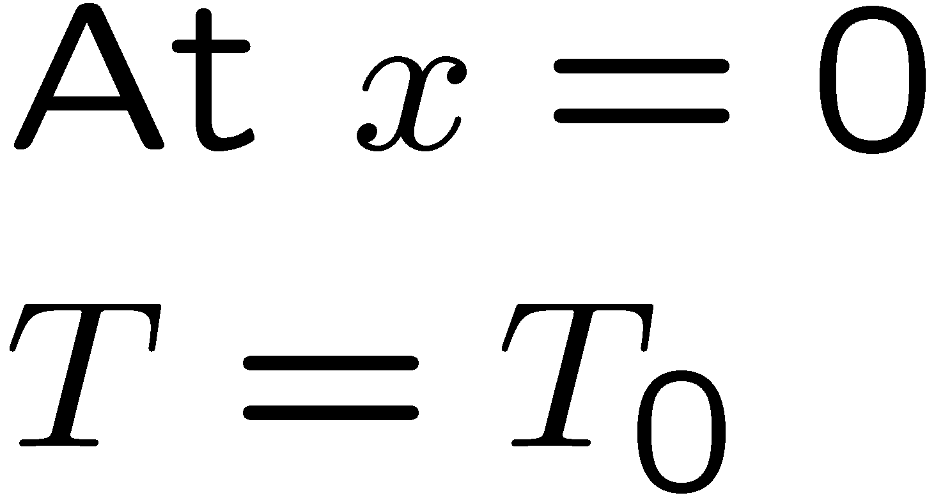

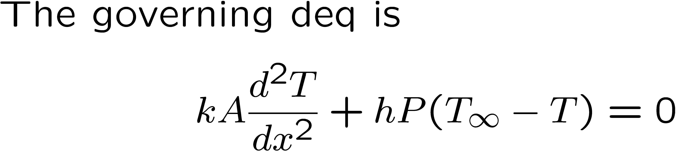
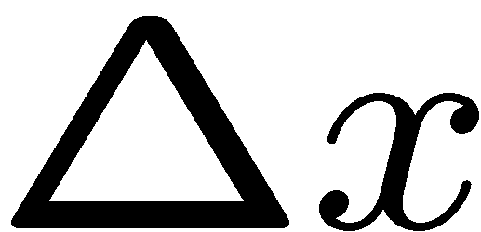
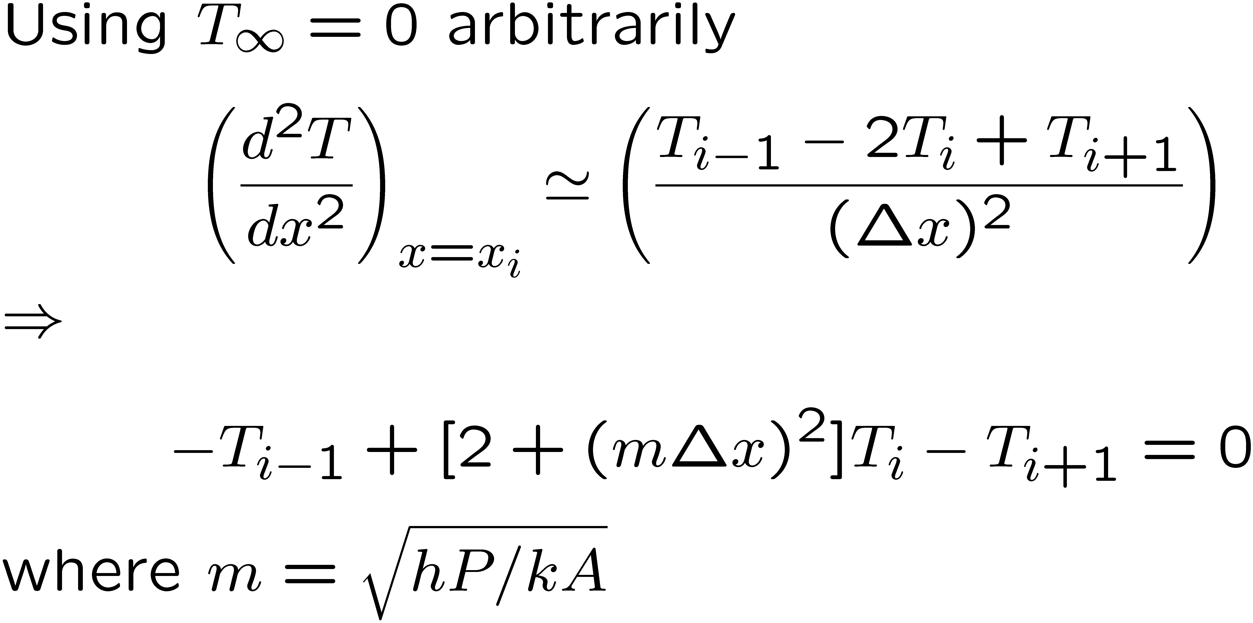
x

Slide 24
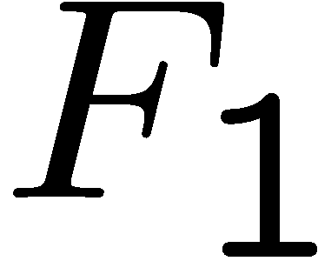
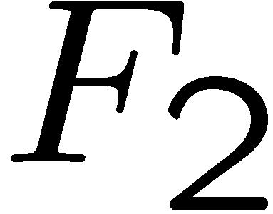
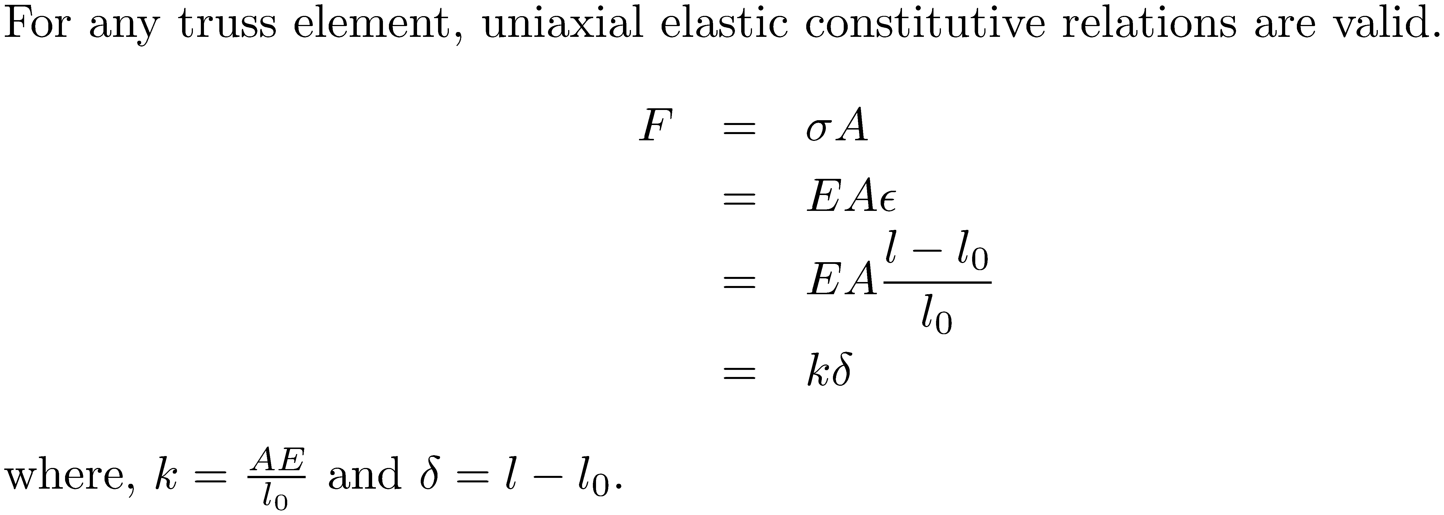
The FEM procedure: a simple view
A 2-d truss with elements that can only withstand tension.

Slide 25
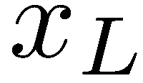

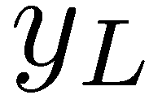

5
4
Direction of stretch
1
2
3
4
2

Slide 26
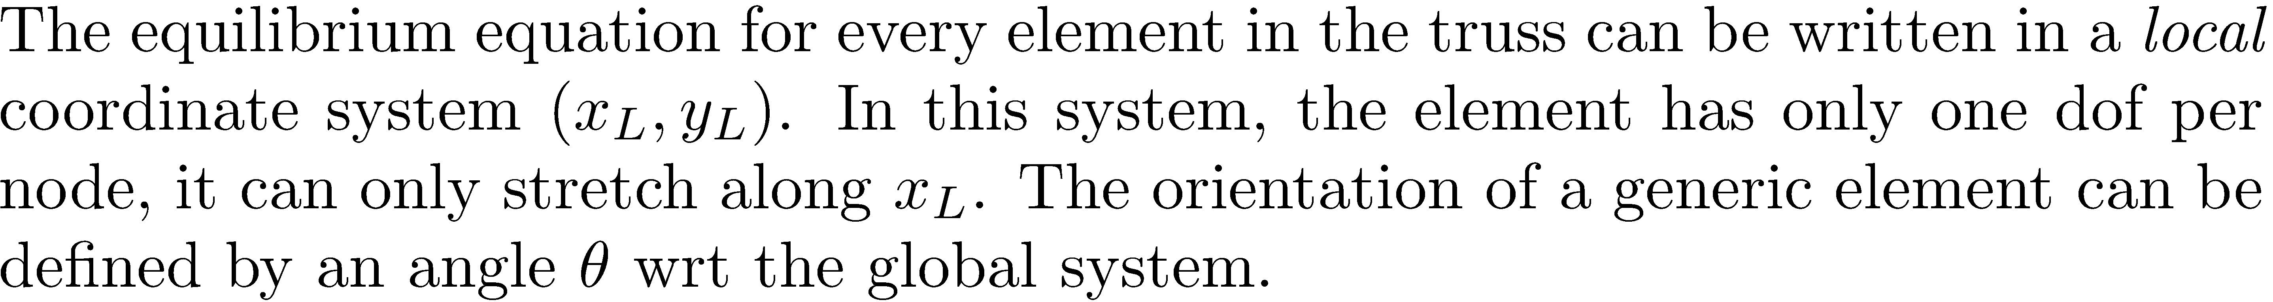




4/2
2/1
4/2
2/1

Slide 27

Local force vector (ndof X nnod,1)
Displacement vector (ndof X nnod, 1)
Local stiffness matrix in local coordinate system (ndof X nnod, ndof X nnod)

Slide 28





x
4
2/1

Slide 29


Slide 30


Slide 31

x
Assembly procedure
4
3/1 4/2 7/3 8/4
y
3/1
4/2
7/3
2
8/4
5
4
Eg: 2,2 → 4,4
3,1 → 7,3
1
2
3

Slide 32
Elem no | Local dof | Destination
1 | 1 | 1
 | 2 | 2
 | 3 | 9
 | 4 | 10
2 | 1 | 3
 | 2 | 4
 | 3 | 9
 | 4 | 10
5
5
4
1
2
4
6
1
3
2
3
7

Slide 33
After assembling elements 1 and 2

Slide 34
X+X | X+X | X | X |  |  |  |  | X | X
X+X | X+X | X | X |  |  |  |  | X | X
X | X | X+X+X | X+X+X |  |  | X | X | X | X
X | X | X+X+X | X+X+X |  |  | X | X | X | X
 |  | X | X | X+X | X+X | X | X
 |  | X | X | X+X | X+X | X | X
 |  | X+X | X+X | X+X | X+X | X+X+X | X+X+X | X | X
 |  | X+X | X+X | X+X | X+X | X+X+X | X+X+X | X | X
X | X | X | X |  |  | X | X | X+X+X | X+X+X
X | X | X | X |  |  | X | X | X+X+X | X+X+X
Stiffness matrix is symmetric, diagonally dominant, sparse and banded.

Slide 35

Sparsity pattern
5
5
4
1
2
4
6
1
3
2
3
7

Slide 36

Half bandwidth
2
5
4
1
2
4
6
1
3
3
5
7

Slide 37

Global displacement vector
Global force vector
Global stiffness matrix
Notes:
Global stiffness matrix is singular i.e. it has zero eigenvalues
Hence it cannot be inverted!

Slide 38


Boundary conditions
Force specified: eg. dof 9 and 10 in our example
Displacement specified: eg. dof 1,2,and 6 in our example
Both forces and displacements cannot be specified at the same dof.

Slide 39
Naïve approach for imposing displacement boundary conditions
L=a very large number. Also replace the corresponding dofs in the rhs vector by LXspecified displacement value

Slide 40


The “proper” way of imposing displacement constraints

Slide 41

Suppose dof k is specified
Traspose negative of the specified value X kth column to the right
Replace k th row and columns in the stiffness matrix to zero
Replace K(k,k) by 1
Set F(k)=specified value
Repeat above steps for all specified dofs.

Slide 42



Stiffness matrix from basics: beam elements
1
2
x
L

Slide 44

Intuitive but not easy
22
12
13

Slide 45






1
2

Slide 46




Slide 47


Slide 48







Beams in 2-d
2
1
3

Slide 49






Transformation Matrix for a 2-d beam element

Slide 50

Solving the equations

Slide 51

Basic Gauss elimination:an example
Original problem
1st elimination:
Row2- Row 1*(-6/18)
Row3-Row1*(-6/18)
2nd elimination
Row3-Row2*(-2/10)
Row4-Row2*(-6/10)
3rd elimination:
Row4-Row3*(-7.2/9.6)

Slide 52


Slide 53






A physical picture of the Gauss elimination procedure

Slide 54


Slide 55




Slide 56



Slide 57

The numerics of Gauss elimination

Slide 58


Slide 59


Slide 60

1
r
1
r

Slide 61


Slide 62

i
r
i
i
i
r

Slide 63


Slide 64


Example
Instead of 0, can be stored.

Slide 65


Slide 66


Slide 67


Slide 68

Exercise

Slide 69


Slide 70

Computation of inverse by LU decomposition

Slide 71

Exercise

Slide 72


Slide 73


Slide 74

Matrix norms and conditioning

Slide 75


Slide 76


Slide 77


Slide 78


Slide 79


Slide 80


Slide 81
The FEM scheme of things
Read in data – mainly nodal coordinates, element connectivity, force and displacement boundary conditions and material properties
Form destination array
For each element
Form local stiffness matrix
Form local rhs vector
Assemble into global stiffness matrix & rhs vector
End
Incorporate boundary conditions into stiffness and rhs
Solve
Stop

Slide 82




Loads and stresses

Slide 83





Slide 84













Slide 85








Slide 86





Slide 87







Slide 88













2
1
3
5
4
6

Slide 89


Slide 90





Slide 91







Slide 92








Slide 93




Slide 94


2
1
3

Slide 95





Slide 96

Introduction to the theory of small strain, linear elasticity

Slide 97


Slide 98


Slide 99


Slide 100


Slide 101


Slide 102


Slide 103






Slide 104


Slide 105


Slide 106


Slide 107


Slide 108











Slide 109

x
w(x)
2h
y
L/2

Slide 110

σ₀
H
y
a
x
w
σ₀

Slide 111

σ₀
H
y
a
x
w
σ₀

Slide 112



x
P
2h
x
a
L

Slide 113


Slide 114


Slide 115


